Slide 1
The MAZE
Jiajia Ding

Slide 2
abstract
At CS455 Algorithm class, Depth-First Search algorithm was introduced to solve the Maze. Depending on the clearness of the route, two different approaches can be used to solve the problem. This slides was created to demonstrate what we have learnt from the class and the circumstances when each approach should be used.

Slide 3
acknowledgement
I would like to thank Professor Henry Chang for sharing with me his time, efforts, and knowledge in the computer science industry.

Slide 4
Table of content
Abstract
Acknowledgement
Introduction
Clear Route (Street, Highway)
Unclear Route (Hotel, Hospital)
Test
Conclusion
Appendix

Slide 5
Introduction
Robot
Clear Route (Street, Highway)
Unclear Route (Hotel, Hospital)
When solving the maze with clear route (Street, Highway), robot without wheel (legged robot) approach is taken. When solving the maze with unclear route (Hotel, Hospital), robot with wheel (self-driving car) approach is taken. ​
When the maze has clear route (street, highway), a tree/graph is created based on the route. And robot without wheel (legged robot) approach is used to solve the maze. An example will be demonstrated in the following slides.
When the maze has unclear route (hotel, hospital), a matrix (grid) is created based on the route. And robot with wheel (self-driving car) approach is used to solve the maze. An example will be demonstrated in the following slides.

Slide 6
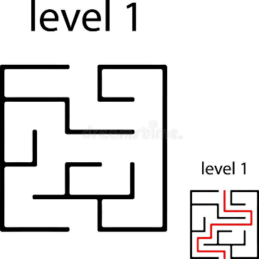
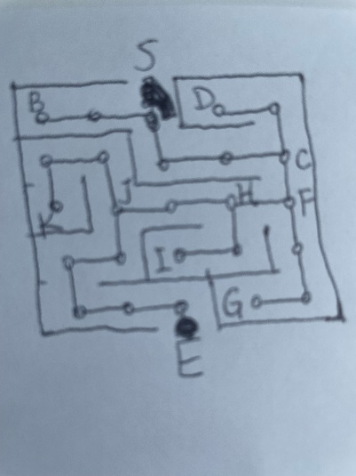
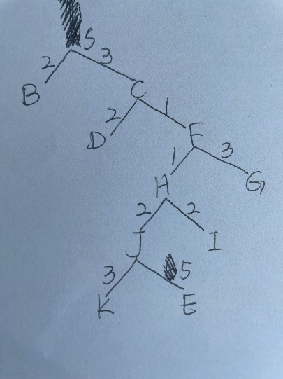
Clear Route (Street, Highway)
In the below example, the best route is highlighted in red. A tree graph is created based on the maze.

Slide 7
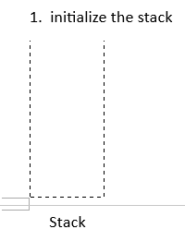
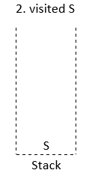
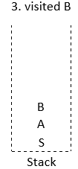
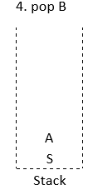
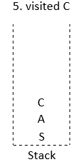
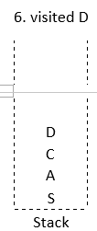
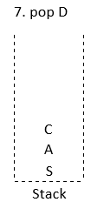
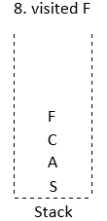
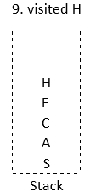
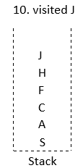
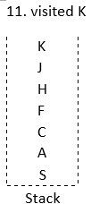
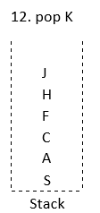
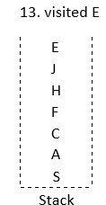
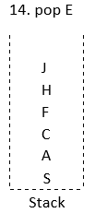


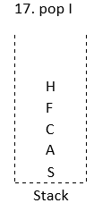
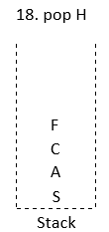
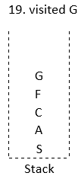
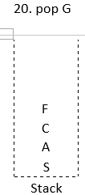
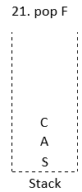
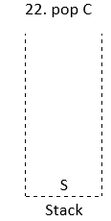
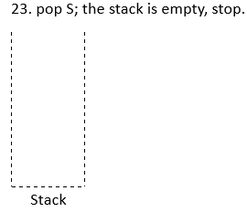
Clear Route (Street, Highway)
In implementation, DFS traversal and stack is used to solve this problem.

Slide 8
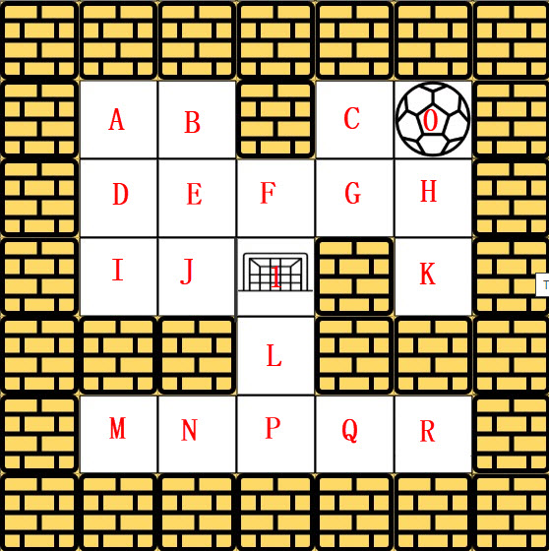
Unclear Route (Hotel, Hospital)
In the below example, the ball indicates the start, and the goal indicates the end. In implementation, DFS traversal and stack is used to solve the problem. How DFS traversal works on the matrix/grid is
Try right, Left, Up, and Down direction in order
When there is a wall, try the next direction
When there is no new route to go, return to the previous step.
When several new steps are in the same row, the wheel can go all the way to the end
 |  |  |  |  |  |  |  |  |  |  |  |  | 1
 |  |  |  |  |  |  |  |  | B |  |  |  | J
 |  |  |  |  |  |  |  | A | A | A |  | I | I
 |  |  |  |  |  |  | D | D | D | D | D | D | D
 |  |  |  | K |  |  | E | E | E | E | E | E | E
 |  |  | H | H | H |  | F | F | F | F | F | F | F
 |  | G | G | G | G | G | G | G | G | G | G | G | G
 | C | C | C | C | C | C | C | C | C | C | C | C | C
0 | 0 | 0 | 0 | 0 | 0 | 0 | 0 | 0 | 0 | 0 | 0 | 0 | 0

Slide 9
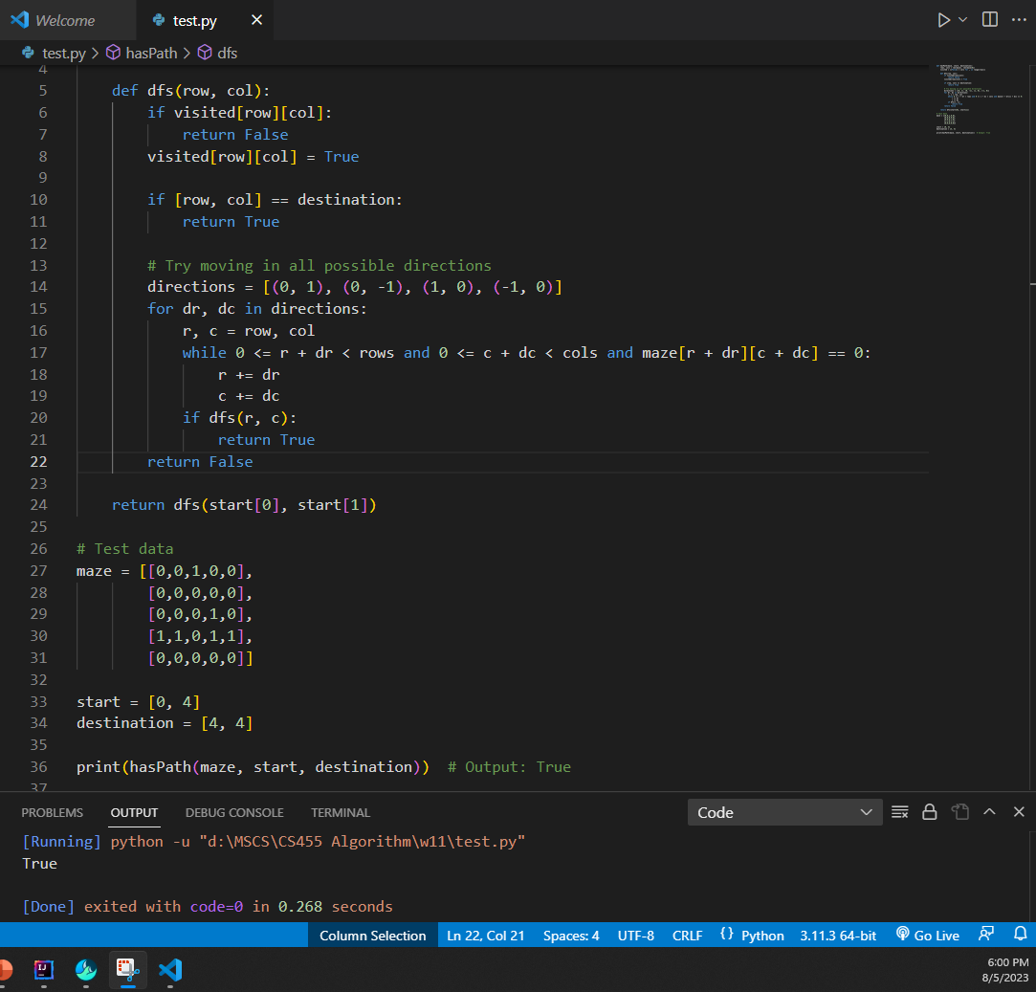
Test
An exemplar code with one test case created by ChatGPT is attached

Slide 10
conclusion
When the maze has clear route, a tree graph should be created and robot without wheel should be used to solve the problem; whenever the maze has unclear route, a matrix/grid should be created and robot with wheel should be used to solve the problem.

Slide 11
Appendix
https://hc.labnet.sfbu.edu/~henry/npu/classes/algorithm/tutorialpoints_dsa/slide/depth_first_traversal.html
https://hc.labnet.sfbu.edu/~henry/npu/classes/introjava/project/slide/structure.html

Slide 12
THANK YOU

